Slide 1

Analysis of Dota2 Wining Rate
Xuansu Zhang 116010301 (Jesse) Zheng Wang 116010232 (Lefe)
Haoyu Wu 116010236 (Matt) Ziyuan Cheng 116010025 (Jermaine)
http://119.29.203.212/dist/index.html

Slide 2
contents
00
02
04
Introduction
Website Design
Data Summary & Prediction
01
03
05
Database Design
Web Crawler
Wining Rate & Anti-Method
http://119.29.203.212/dist/index.html

Slide 3
Introduction
Our team aim at building a website based on Dota2 heroes' data. It can help people to predict their winning rate and choose a better line-up.
00
http://119.29.203.212/dist/index.html

Slide 4


Two modes
*5
*5
*5
00
http://119.29.203.212/dist/index.html

Slide 5
Database Design
01
http://119.29.203.212/dist/index.html

Slide 6
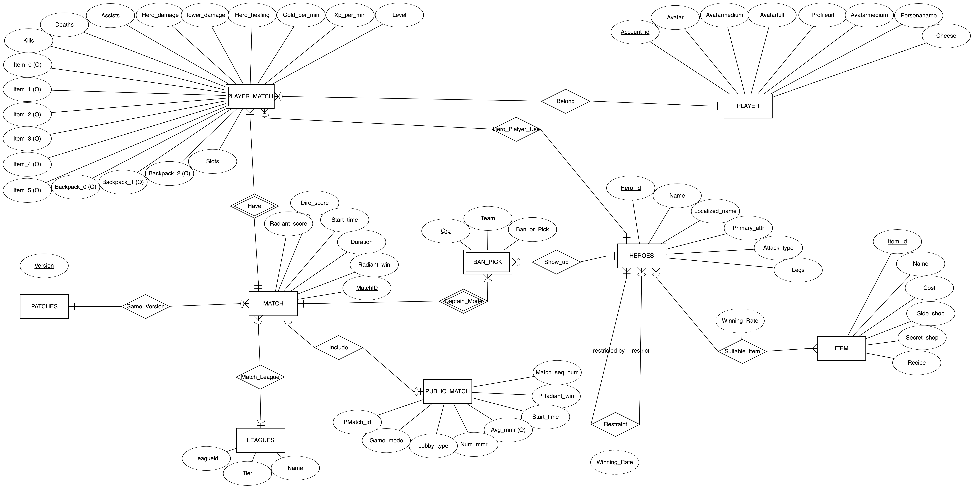
ER-Diagram
http://119.29.203.212/dist/index.html

Slide 7
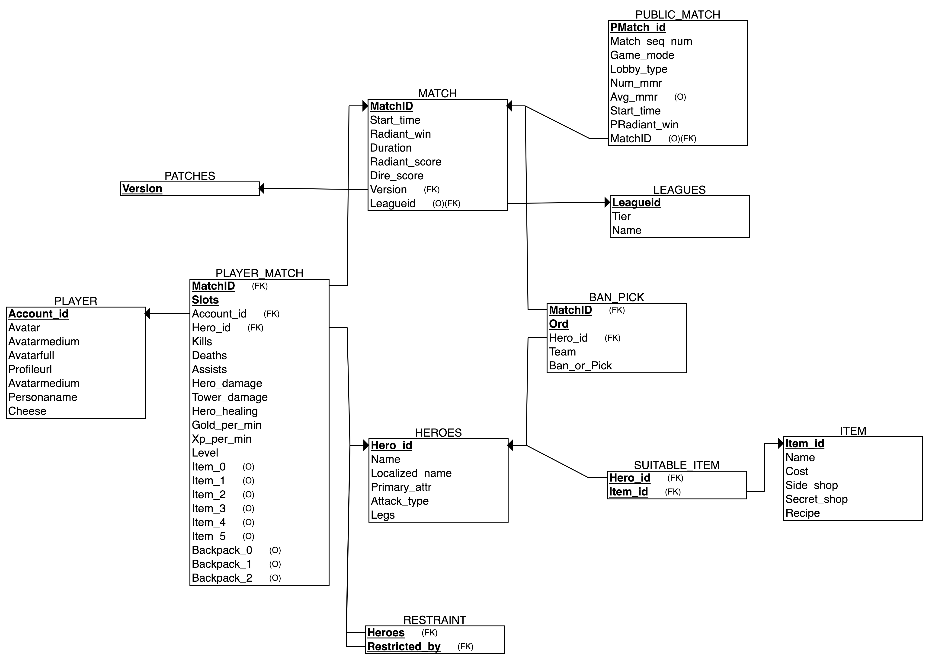
Relational Schema
http://119.29.203.212/dist/index.html

Slide 8
Website Design
02
http://119.29.203.212/dist/index.html

Slide 9
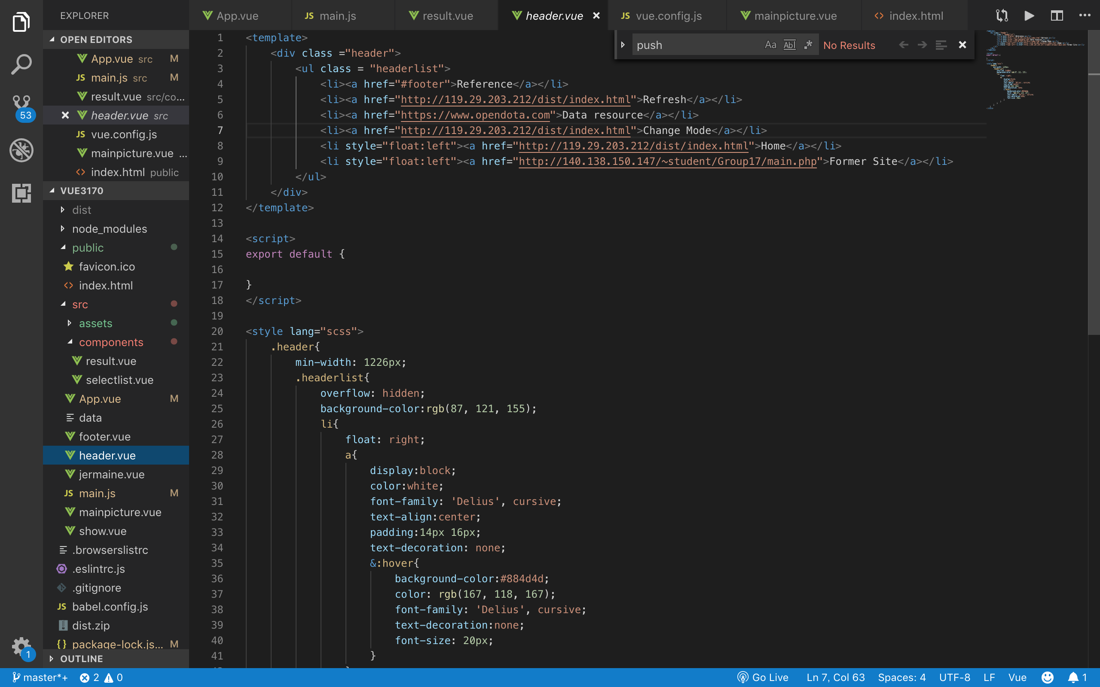
Web Development
HTML
Vue
JAVASCRIPT
The front end of our project is based on webpack: Vue CLI 3.X
SASS
VUE.js
Vue.axios
http://119.29.203.212/dist/index.html

Slide 10
Web Crawler
03
http://119.29.203.212/dist/index.html

Slide 11
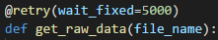
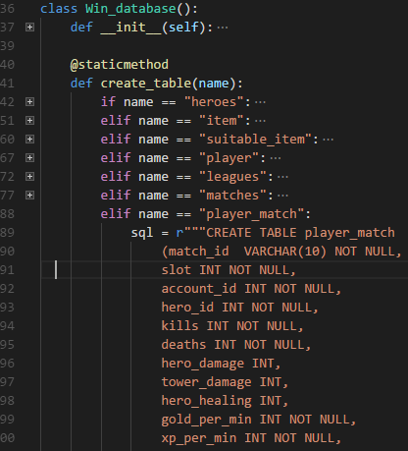
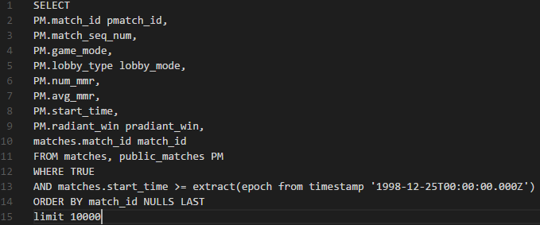
Web Crawler
Data
Preprocessing
Crawler
Database: Win
Open Dota Database
http://119.29.203.212/dist/index.html

Slide 12
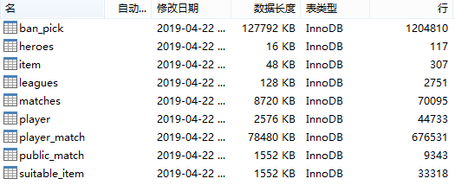
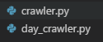
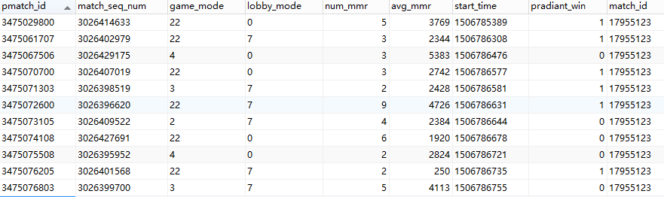
Web Crawler
http://119.29.203.212/dist/index.html

Slide 13
Data Summary & Prediction
04
http://119.29.203.212/dist/index.html

Slide 14
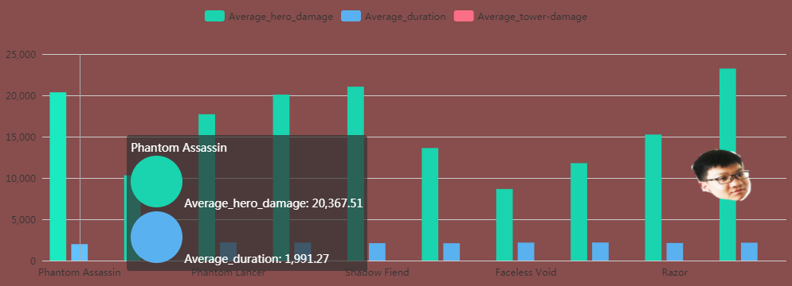
Data Summary
http://119.29.203.212/dist/index.html

Slide 15
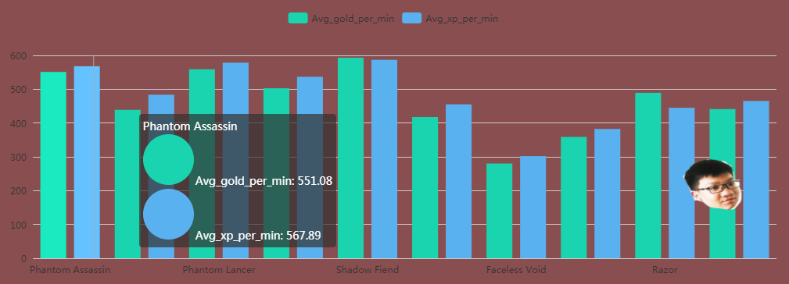
Data Summary
http://119.29.203.212/dist/index.html

Slide 16
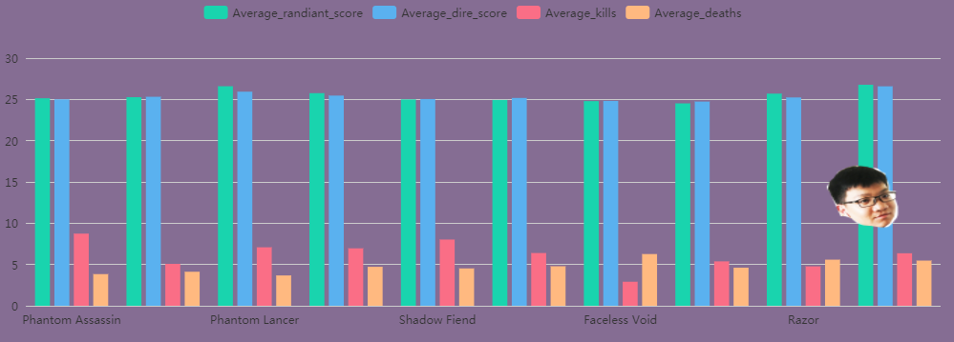
Data Summary
http://119.29.203.212/dist/index.html

Slide 17
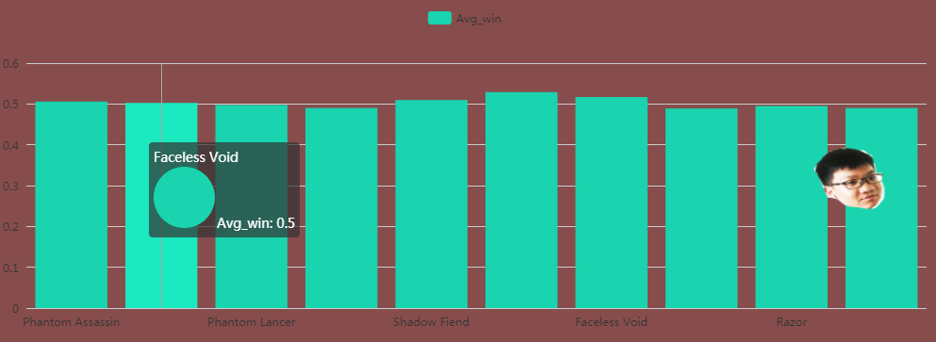
Data Summary
http://119.29.203.212/dist/index.html

Slide 18
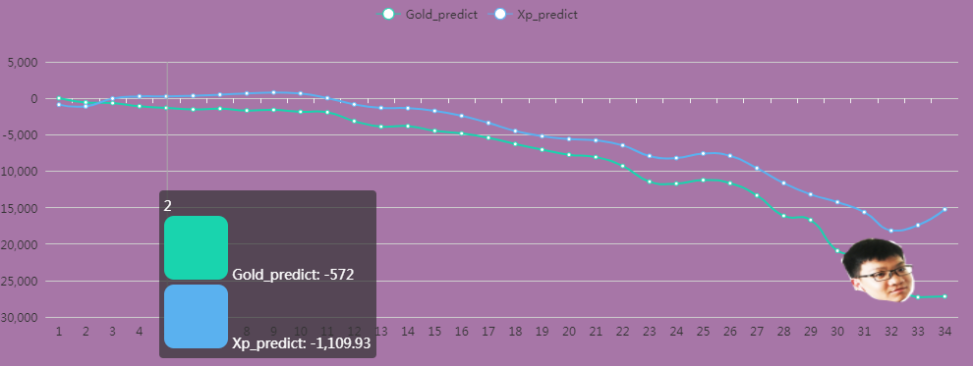
Data Prediction
Better prediction of Radiant Experience array using predicted Radiant Gold array as input
Array of the Radiant experience (xp) advantage at each minute in the game.
A negative number means that Radiant is behind, and thus it is their gold disadvantage.
http://119.29.203.212/dist/index.html

Slide 19
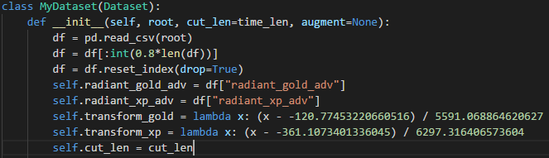
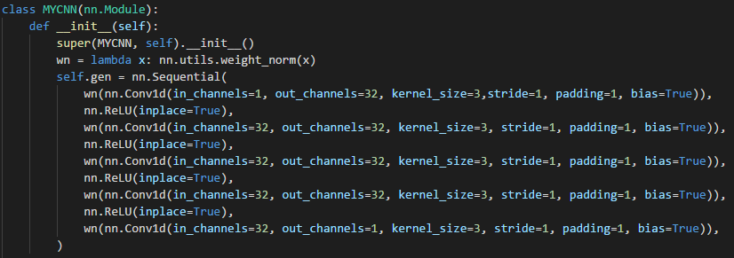
Data Prediction
Better prediction of Radiant Experience array
Normalization
Seq-Seq Neural Network
http://119.29.203.212/dist/index.html

Slide 20
Wining Rate & Anti-Method
05
http://119.29.203.212/dist/index.html

Slide 21
Algorithm (Wining Rate)
Get the win rate for a hero with another hero.
Get the win rate for a hero with a team.
Get the win rate for the two teams.
Repeat the operation in the next five time interval.
http://119.29.203.212/dist/index.html

Slide 22
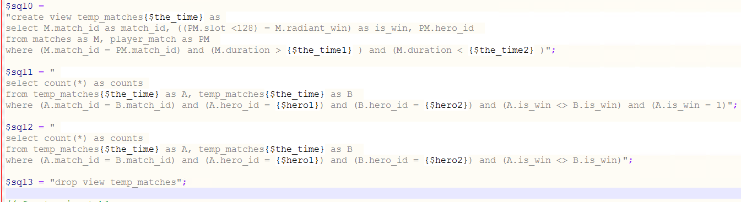
Implementation (Wining Rate)
total_match = all professional matches that hero A and hero B fight as enemy (in the required tine interval)
total_win = the amount of matches that A wins in total_match;
basic winning rate = total_win/total_match
http://119.29.203.212/dist/index.html

Slide 23
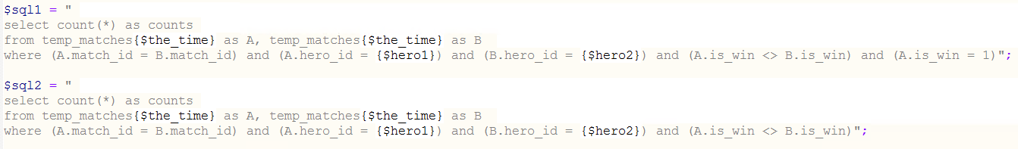
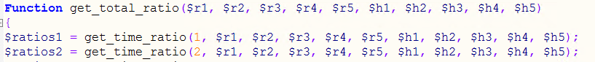
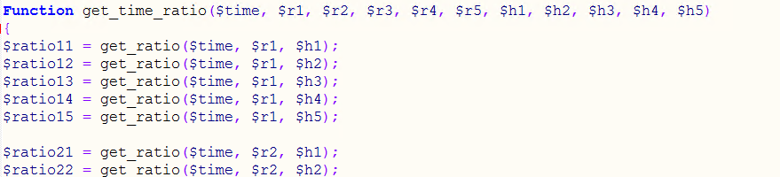
Implementation (Wining Rate)
1:
2,3:
4:
http://119.29.203.212/dist/index.html

Slide 24
Algorithm (Anti-Method)
Create a view about heroes rate like what “wining rate” does.
Get the top five heroes for every target hero.
Return the best anti-team and the “wining rate”.
http://119.29.203.212/dist/index.html

Slide 25
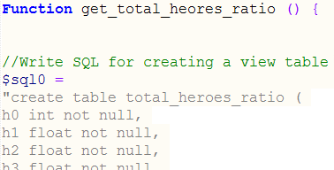
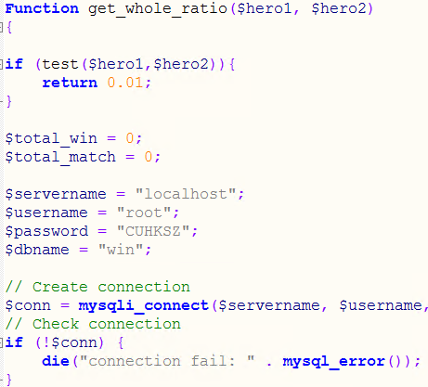
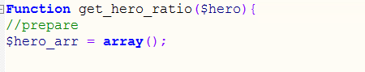
Implementation (Anti-Method)
http://119.29.203.212/dist/index.html

Slide 26
Work
http://119.29.203.212/dist/index.html
 | Work | Explanation | Who are in charge? (in no particular order)
Regular | Database design |  | Zheng Wang
Regular | Website design
Regular | Data Collection | Using mysql statement to download matches and heroes data from a big database called OpenDota. | Ziyuan Cheng
Regular | Server set-up and front-end Connection | Set-up the server which rented from Tencent Cloud to make it having the right operating environment and having access via external network. Connect the front-end to make sure or change the data type they send to each other can be acceptable.
Regular | Web crawler |  | Haoyu Wu & Xuansu Zhang
Regular | Data summary of each competition; Winning percentage of various lineups; Winning ratio of two sides | Summarize the information in the database that is related to the user's input; The winning percentage of competitions recorded in the database, used to predict winning rate of user's input heroes; Predict wining ratio of two sides (user's input heroes)
Regular | Anti-method (Recommendation Algorithm) | Recommend 5 heroes to fight | Xuansu Zhang
Newly added | Gold & XP (Data Prediction) | Predicting gold and experience data (array) of first 34 minutes | Haoyu Wu

Slide 27
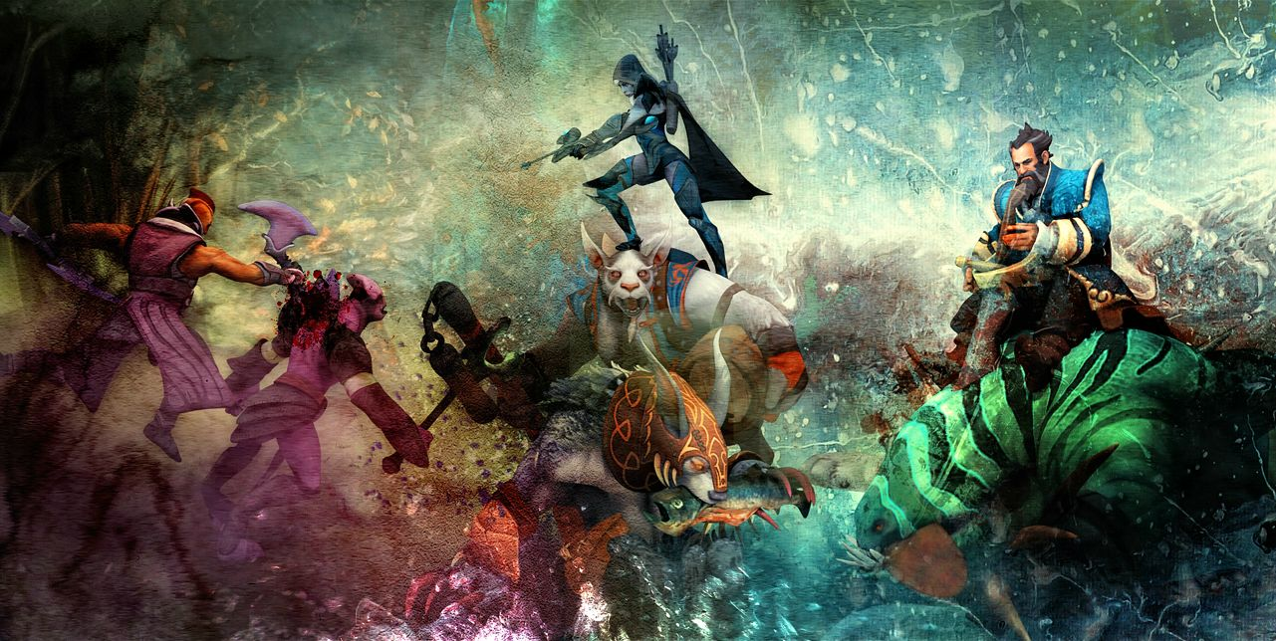
Thank you!
http://119.29.203.212/dist/index.html

